Slide 1

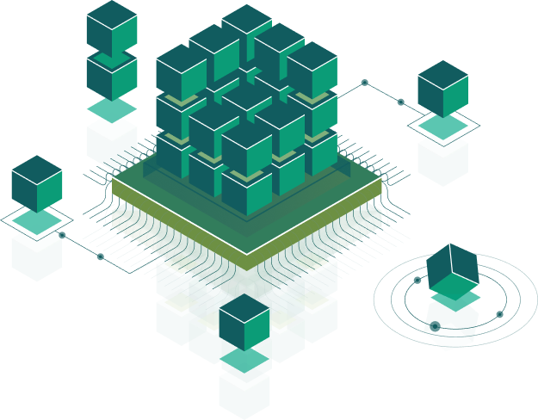
Трейдингова платформа, яка дозволяє здійснювати:
торгівлю;
спостереження за стратегіями найкращих
трейдерів;
моніторинг даних у реальному часі.
Project made by Magnis Academy students

Slide 2

Technology stack backend:
Microservices architecture
Docker
MySQL
ASP.Net Core
Entity Framework Core
Identity Server 4
RabbitMQ
Implemented RESTful API and WebSocket for web and mobile application.

Slide 3
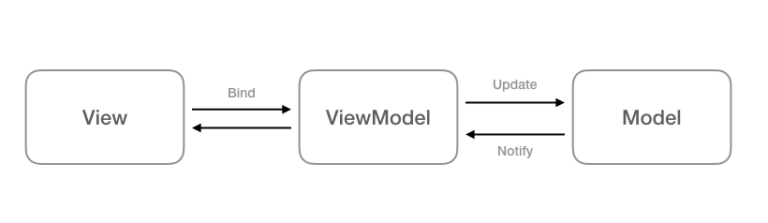
Technology stack front-end:
HTML, CSS (preprocessor SCSS)
Angular 8
Angular Material UI
Angular uses a pattern MVVM

Slide 4
Technology stack Android:
Retrofit 2, REST API
Glide
Kotlin
XML
MVVM Architecture
Git
Technology stack iOS:
Alamofire, REST API
Swift
Cocoa Touch
Cocoa Pods
Git, Carthage
MVVM Architecture

Slide 5
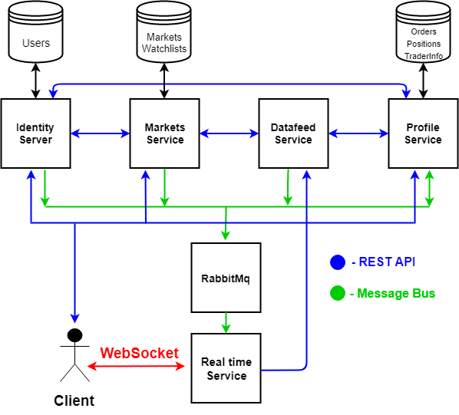

Slide 6
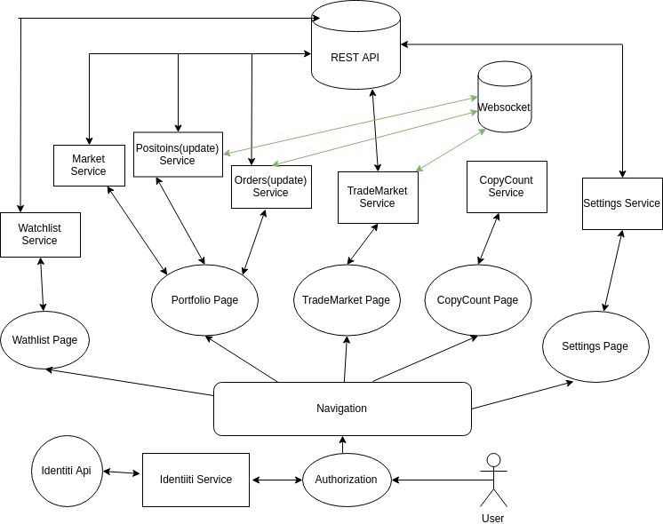

Slide 7
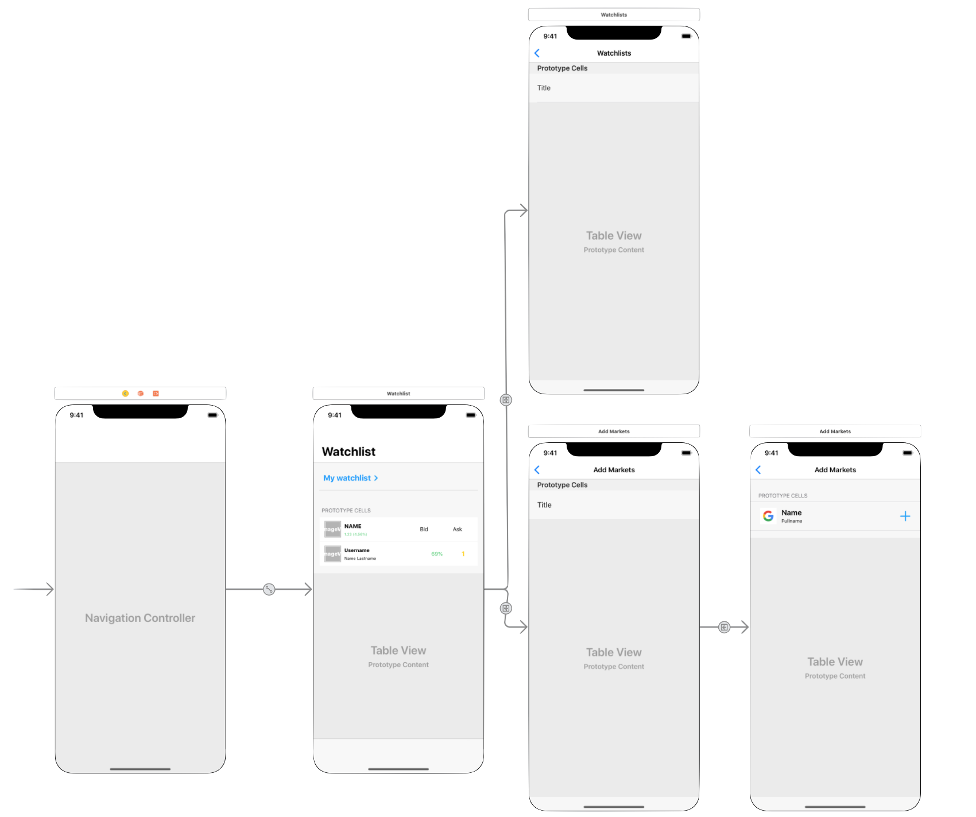
Navigate between View Controllers via Segue for iOS App

Slide 8
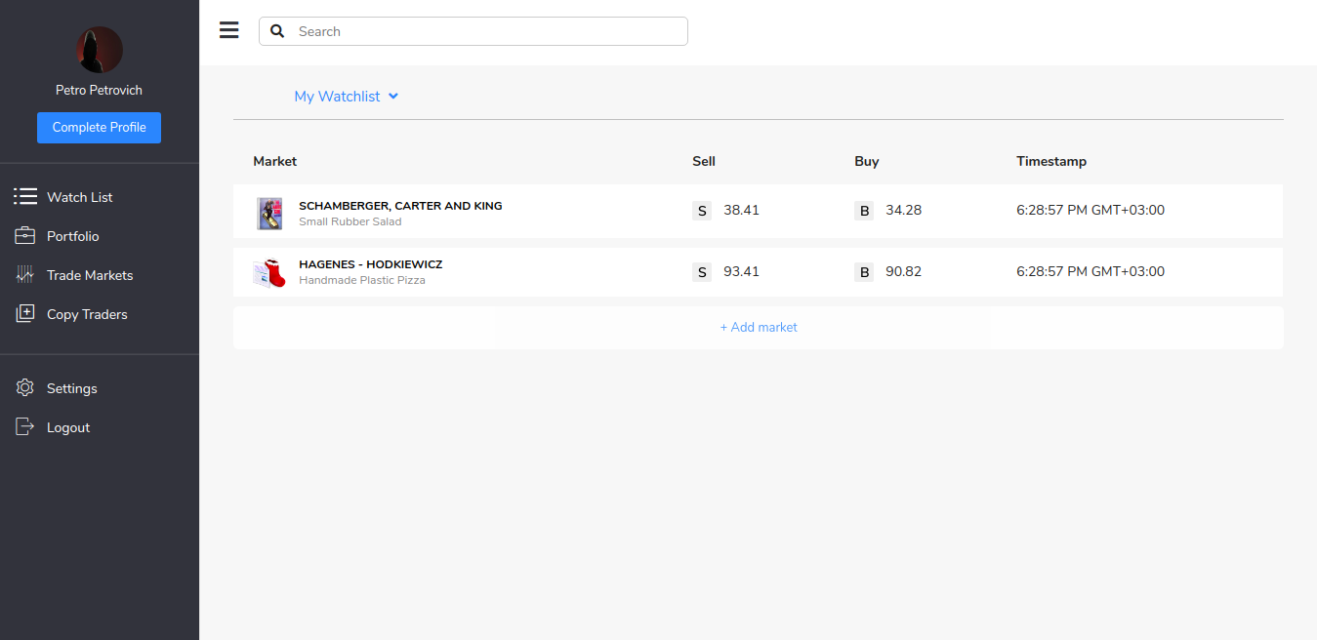
Web-page watchlist

Slide 9
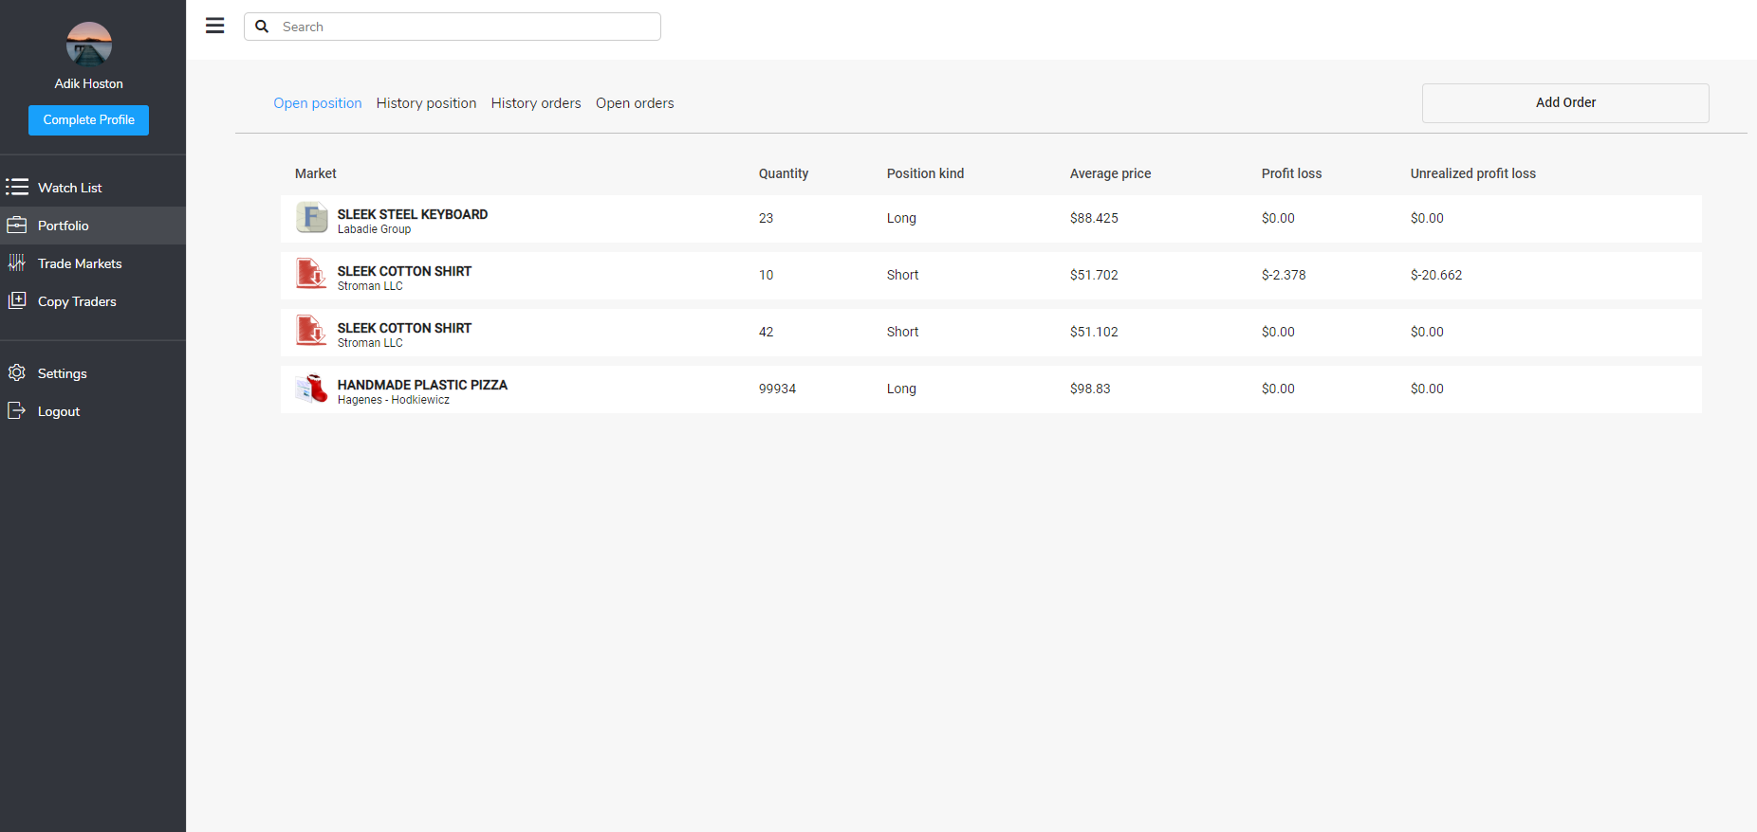
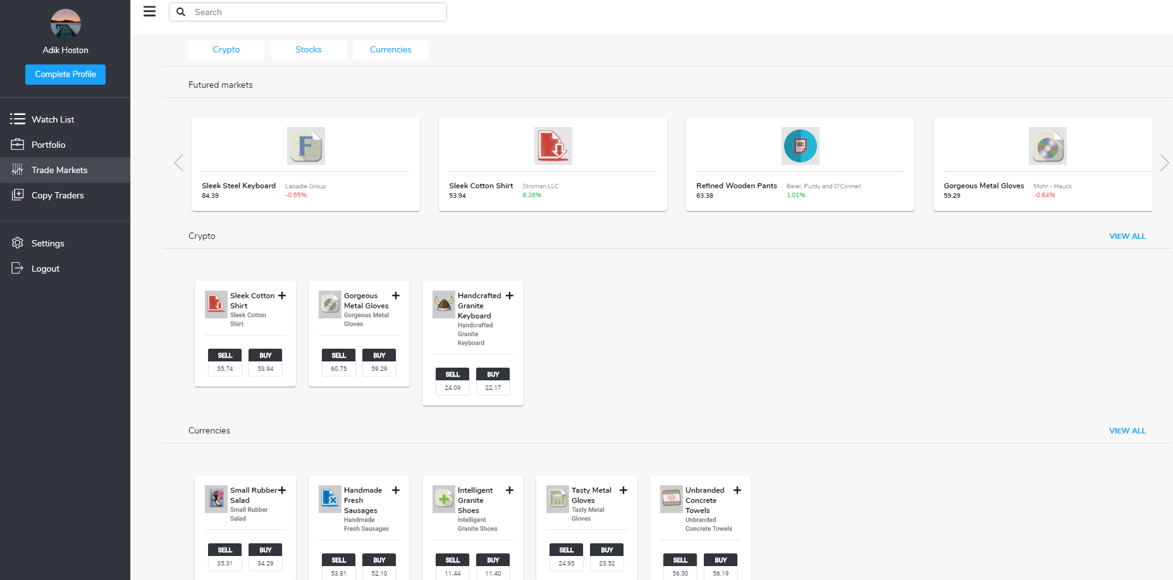
Web-page watchlist
Trade markets
Here displayed common list of all markets and is a possibility navigate to markets with a specific type
Portfolio
On this page are displayed lists of orders and positions, there is a possibility to create new orders.

Slide 10
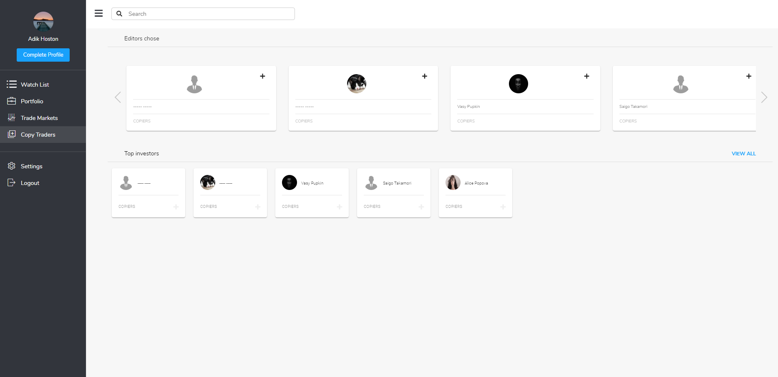
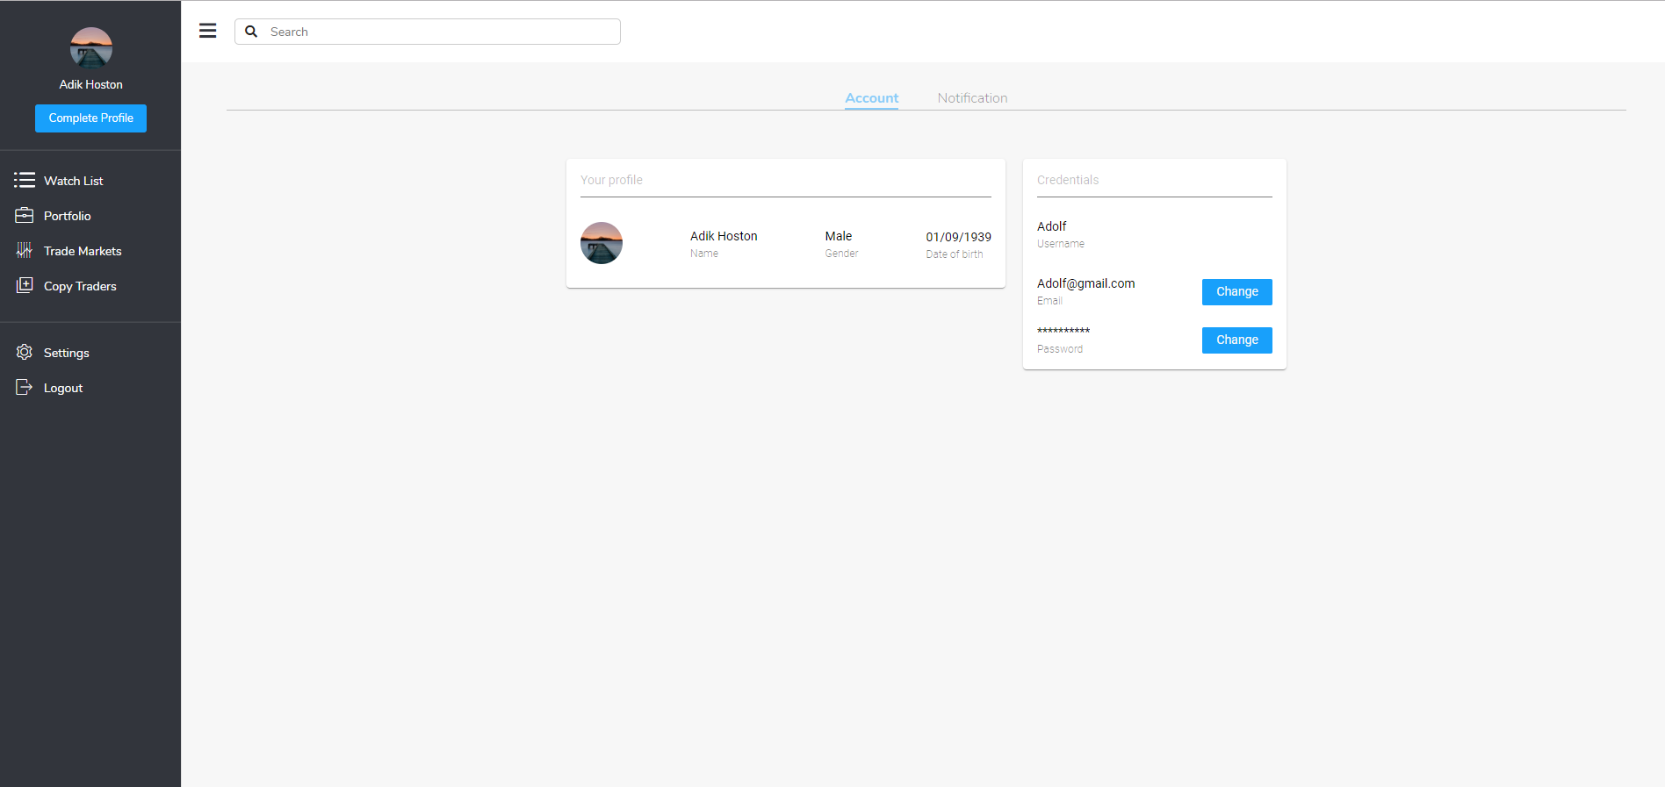
Web-page watchlist
Settings
Account settings for example change of name, password, etc.
Copy traders
Here is a list of all traders and general information about them

Slide 11
Demo:
http://178.238.232.196:15685

Slide 12
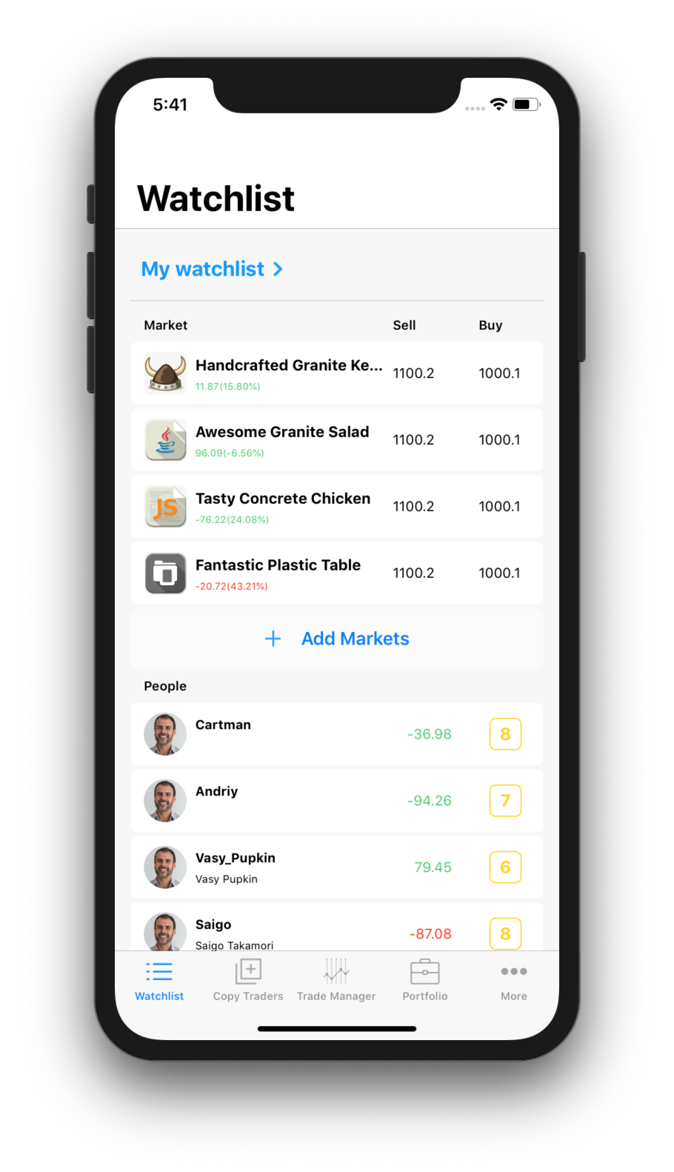
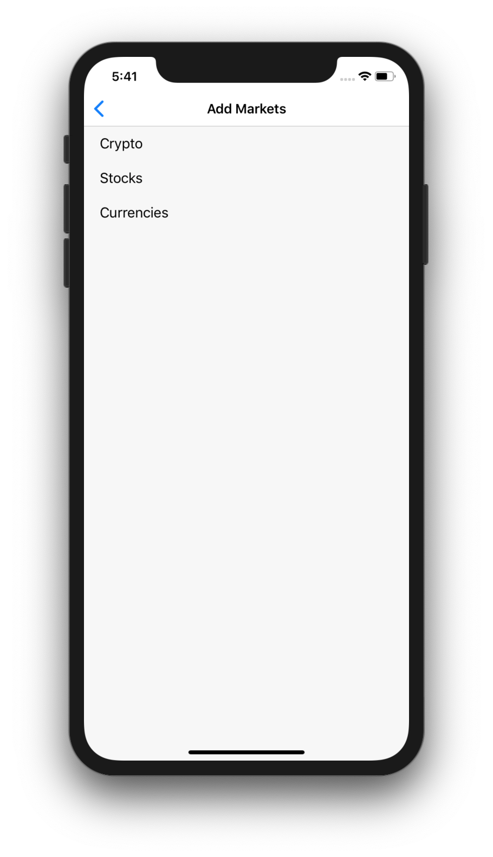
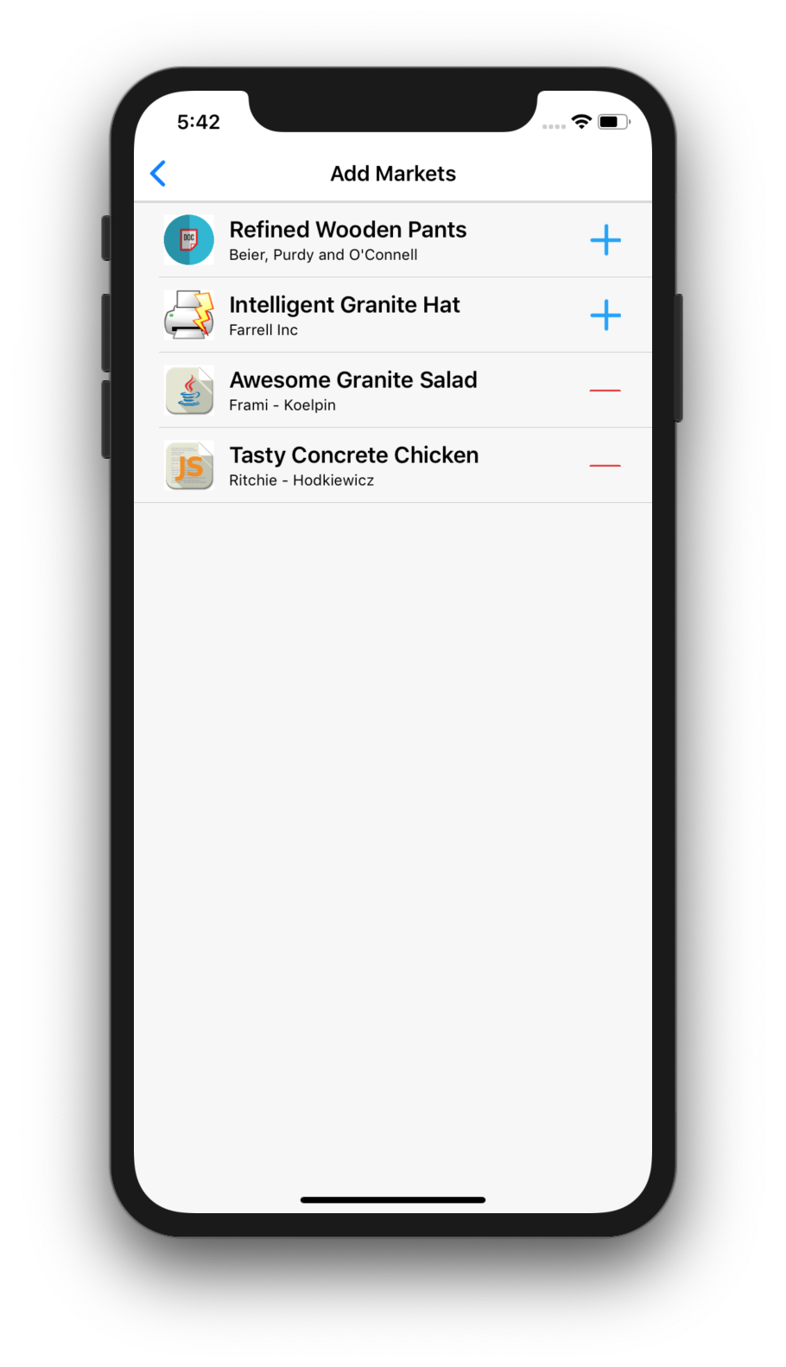
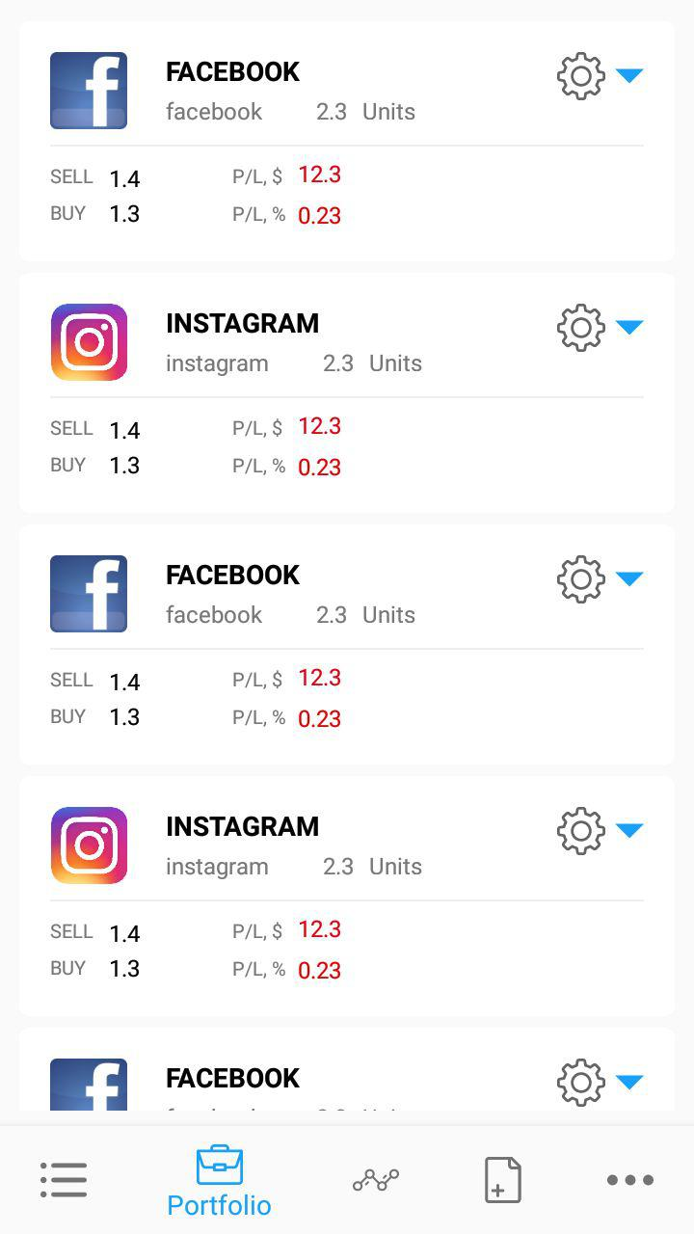
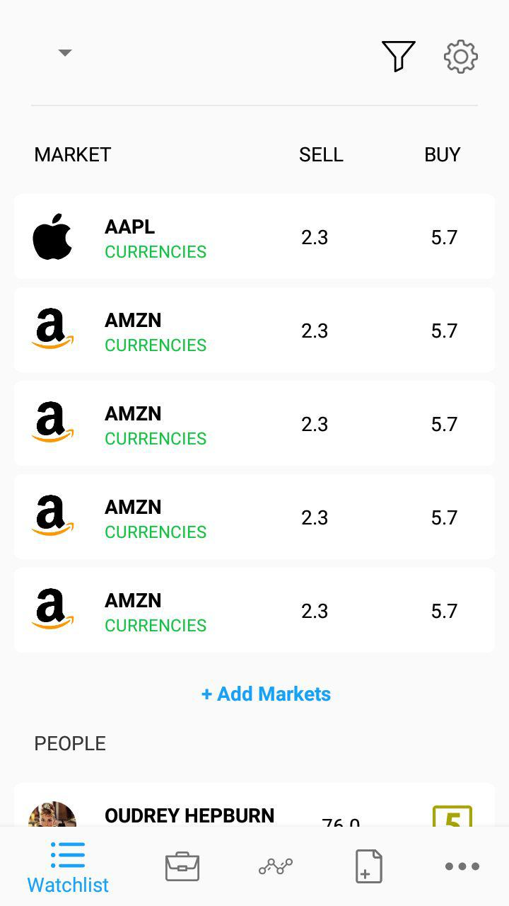
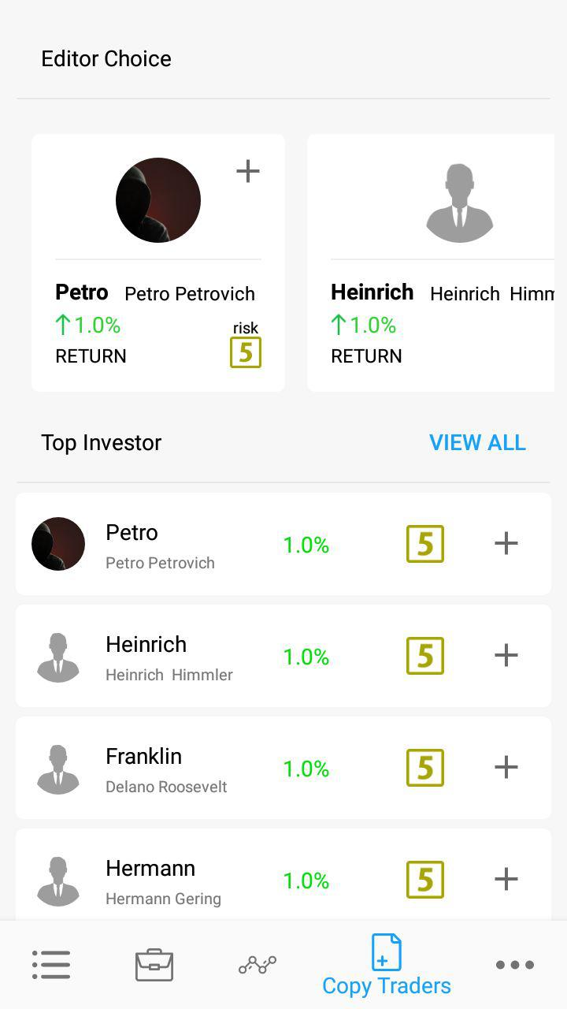
Compare Android and iOS App
Custom list of markets and people lists
Market categories
List markets of one category

Slide 13
Team Composition
Time spent
9 Backend developers
366 hours total
4 Frontend developers
130 hours total
5 Android developers
165 hours total
3 IOS developers
162 hours total
Android - 5
IOS - 3
FrontEnd - 4
BackEnd - 9
Khrystyna Gryb
Vlad Kondratiok
Victor Rykalyuk
Olexandr Stoyko
Ivan kashtelyan
Bohdan Hodovanets
Andrian Nebeso
Mikhailo Pidhorodetskyi
Maria Berestovska
Andrii Krashivskiy
Misha Ilchyshyn
Mykola Andrushchack
Bereza Yurii
Nagaieno Valeriy
Demiak Volodimir
Sytnyk Oleh
Maltsev Vitalii
Mykola Zaiarnyi
Oleh Kuziv
Patsula Vitya
Zubyk Andriy

Slide 14

Thank you!

